Slide 1
Agile Methodology Tutorial
PDF Version
Agile is a software development methodology to build a software incrementally using short iterations of 1 to 4 weeks so that the development is aligned with the changing business needs. This simple tutorial uses appropriate examples to help you understand agile development in a general and quick way.

Slide 2
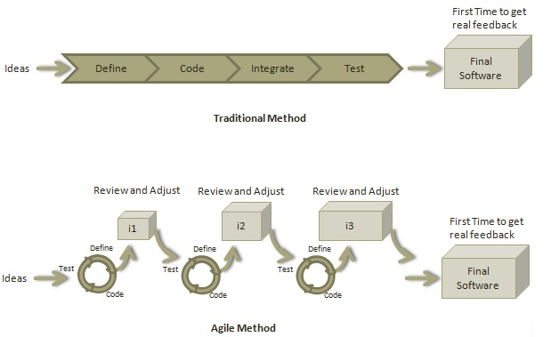
AGILE METHODOLOGY

Slide 3
SCRUM
Scrum is a process framework that has been used to manage complex product development since the early 1990s.
Scrum is not a process or a technique for building products; rather, it is a framework within which you can employ various processes and techniques.
Scrum makes clear the relative efficacy of your product management and development practices so that you can improve.

Slide 4
TECHNOLOGIES USED
METEOR JS (BACK END)
REACT JS (FRONT END)
DATABASE MONGO-DB
ALL PLATFORM SUPPORTED (iOS, Android, Desktop and Web App)

Slide 5
What is Meteor JS?
Meteor is a full-stack JavaScript platform for developing modern web and mobile applications.
Meteor includes a key set of technologies for building connected-client reactive applications, a build tool, and a curated set of packages from the Node.js and general JavaScript community.

Slide 6
Features of Meteor
Web and Mobile − Meteor offers platform for developing Web, Android and IOS apps.
Universal Apps − The same code for web browsers and mobile devices.
Packages − Huge number of packages easy to install and use.
Meteor Galaxy − Cloud service for Meteor app deployment.

Slide 7
Advantages of Meteor.Js
Developers only need JavaScript for server and client side development.
The coding is very simple and beginner friendly.
Meteor apps are real time by default.
Official and community packages are huge time saver.

Slide 8
What is React js ?
React is a library for building composable user interfaces.
It encourages the creation of reusable UI components which present data that changes over time.
Lots of people use React as the V in MVC.
React can also render on the server using Node, and it can power native apps using React Native.

Slide 9
Features of React.js?
JSX − JSX is JavaScript syntax extension. It isn't necessary to use JSX in React development, but it is recommended.
Components − React is all about components. You need to think of everything as a component. This will help you to maintain the code when working on larger scale projects.
Unidirectional data flow and Flux − React implements one way data flow which makes it easy to reason about your app. Flux is a pattern that helps keeping your data unidirectional.
License − React is licensed under the Facebook Inc. Documentation is licensed under CC BY 4.0.

Slide 10
Real Time Applicaiton (Publish and Subscribe)
Meteor has a feature called publish subscribe which is based on producer consumer model.
This feature, pub and sub, of meteor helps in developing real time applications which based on socket connection using D.D.P (Distributed Data Protocol).

